Slide 1

IMDB MOVIE ANALYSIS
TRAINITY
PRESENTED BY: KOMAL BARHATE

Slide 2
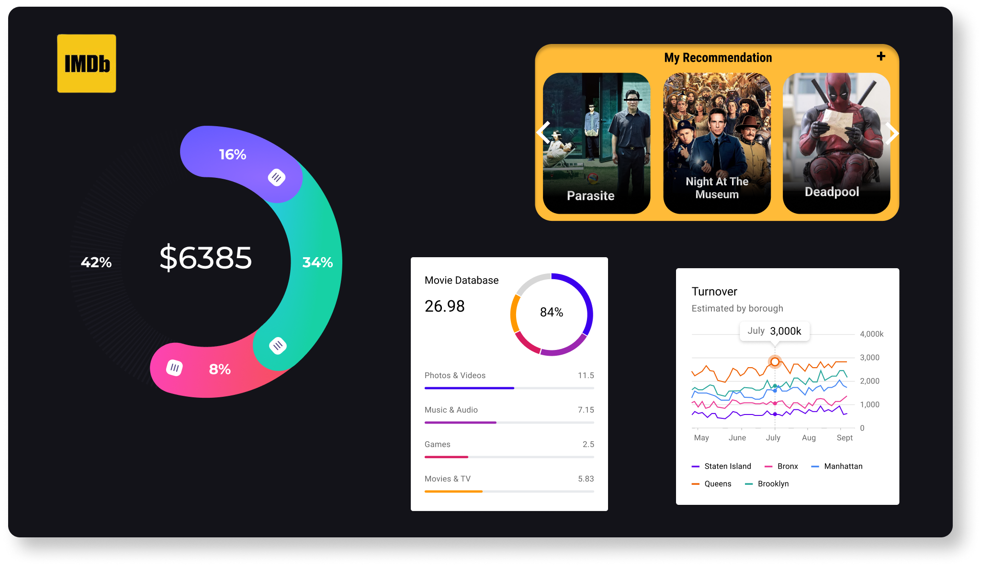
Delivery is essential to the whole package of your presentation.
Present like a pro with these suggestions.

Slide 3
AGENDA
1
PROJECT DESCRIPTION
4
iNSIGHTS
2
APPROACH
5
RESULTS
3
TECH-STACK USED
6
CONCLUSION
03

Slide 4
04
We're delving into IMDb's dataset, encompassing movies from 1920 to 2010 and including crucial details like budgets, collections, cast, and crew. With Office 365 Excel, we're cleaning this data to extract valuable insights. Using the Five Whys method for analytics, we're unraveling the underlying causes behind movie success factors. Through data-driven analysis and storytelling, we're crafting actionable insights to empower stakeholders.
PROJECT DESCRIPTION

Slide 5
05
Approach
TECH-STACK USED
I'll begin by gaining a thorough understanding of the dataset. Next, I'll clean the data by removing null values and unnecessary columns. Using pivot tables, functions, and charts, I'll extract desired insights. Applying the 'Whys' technique, I'll uncover the root causes behind the data trends. Finally, I'll present my findings in well-formatted tables and graphs.
The tech stack for this project primarily involves Microsoft Excel for data cleaning, analysis using pivot tables and functions, and creating visualizations such as charts and graphs for presentation. Additionally, tools like Office 365 Excel are utilized for their robust data manipulation and visualization capabilities.

Slide 6
Insights: Data Cleaning
1.Dropping Unnecessary columns:
Color, director_facebook_likes, actor_3_facebook_likes, actor_2_name, actor_1_facebook_likes, cast_total_facebook_likes, actor_3_name, facebook number_in_posts, plot_keywords, content_rating, actor_2_facebook_likes, aspect_ratio, movie_facebook_likes.
2.Handling Missing Values:
Missing values in the dataset will be handled by replacing them with 0, ensuring consistency in data processing and analysis within Microsoft Excel.
06

Slide 7
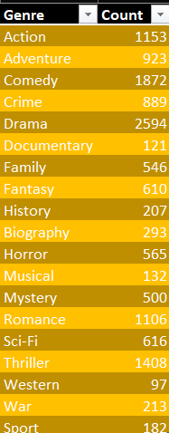
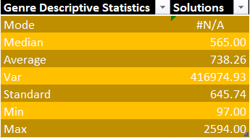
A. Movie Genre Analysis:
ANALYZE THE DISTRIBUTION OF MOVIE GENRES AND THEIR IMPACT ON THE IMDB SCORE.
MODE IS N/A AS THE COUNT HAVE NOT REPEATED THEMSELVES.
07

Slide 8
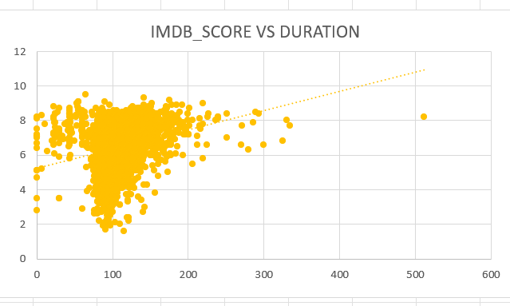
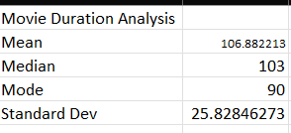
B. MOVIE DURATION ANALYSIS:
Analyze the distribution of movie durations and its impact on the IMDB score.
08

Slide 9
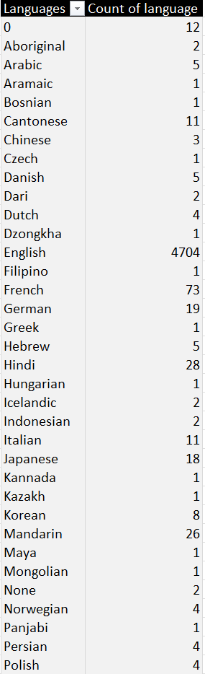
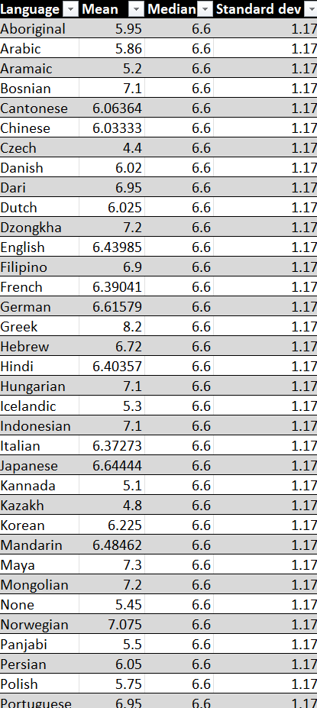
C. LANGUAGE ANALYSIS:
Count of Languages:
Mean, Median, Standard deviation of Langauges using IMDB_Score:
09

Slide 10
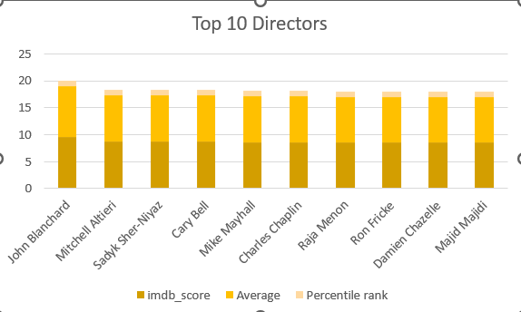
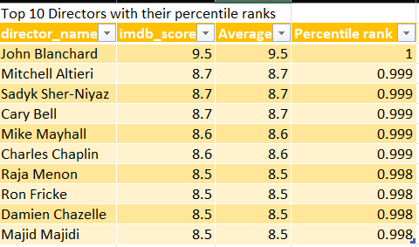
D. Director Analysis:
INFLUENCE OF DIRECTORS ON MOVIE RATINGS.
Top 10 Directors with their Average ratings and percentile Ranks:
Plot of Directors VS Ratings:
10

Slide 11
E. Budget Analysis:
EXPLORE THE RELATIONSHIP BETWEEN MOVIE BUDGETS AND THEIR FINANCIAL SUCCESS.
Profit is calculated by formula: Gross-Budget.
Correlation is calculated using CORREL function and the value close to 1 have highest profit margin.
So the Maximum profit is 523505847 which will have the budget more than 2370000000.
We observe that to get the maximum profit, the budget is generally more than 2000000000.

Slide 12



Thank You!
komalbarhate2004@gmail.com
https://www.linkedin.com/in/komal-barhate
Excel File Link

